Slide 1
NYC ETL Data Pipeline
By: ONIBIYO Joshua Toluse

Slide 2
Project Overview
The goal of this project was to design and implement a data pipeline to transform raw NYC data into actionable insights.
We processed payroll, employee, agency, and title data, storing it in an RDS PostgreSQL data warehouse.
The pipeline ensures scalability, reliability, and flexibility for further enhancements.

Slide 3
Source Data
Our data sources include four categories, all stored in S3 buckets:
Payroll Data
Employee Data
Title Data
Agency Data.
These datasets are in CSV format and are extracted periodically.
Each dataset represents a critical piece of NYC administrative and payroll operations.

Slide 4
ETL Pipeline Design
Here’s how we designed the ETL pipeline:
Data is extracted from S3 buckets.
It is transformed using AWS Glue to handle issues like null values, typecasting, and standardizing fields.
Cleaned and validated data is loaded into RDS PostgreSQL tables.
AWS Glue was selected for its serverless architecture and seamless integration with other AWS services.
We also archive source files into separate S3 locations post-processing.

Slide 5
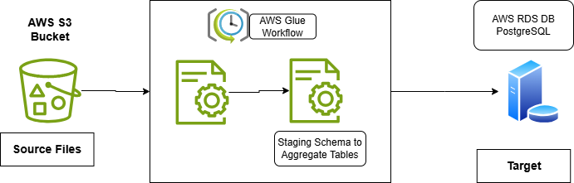
ETL Pipeline Design

Slide 6
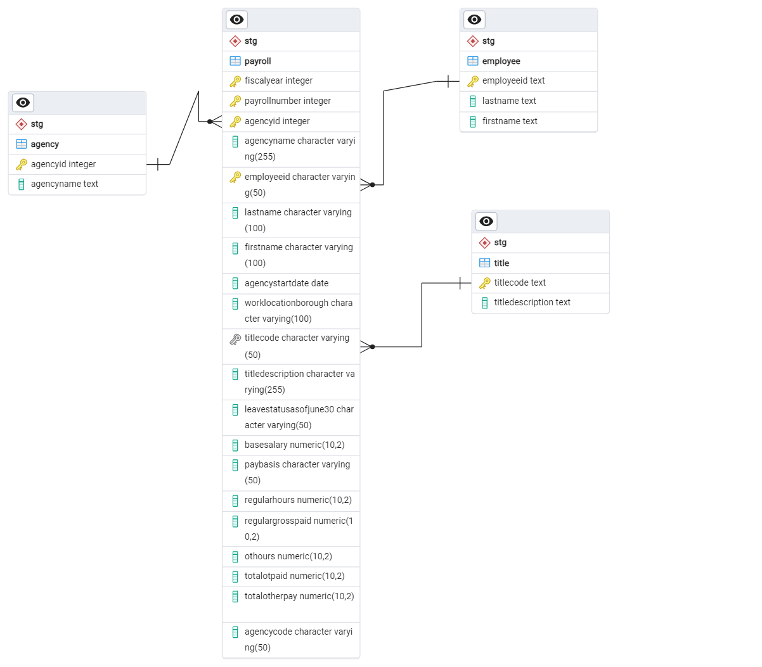
Dimensional Model

Slide 7
Data Flow Architecture
Source data in S3 flows into AWS Glue for ETL.
Processed data is stored in RDS PostgreSQL tables.
Invalid records are logged into a separate issues table.
All source files are archived in S3
Then a stored procedure is used to create aggregate tables for insights

Slide 8
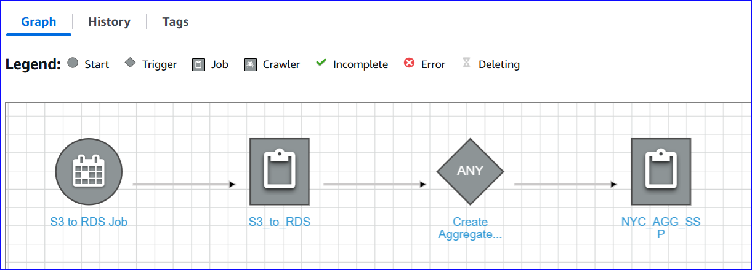
Data Flow Architecture

Slide 9
Aggregate tables
Analyze total salary, overtime, and other payments by fiscal year, agency, and title
Salary Analysis – by fiscalyear, agencyid, titlecode
Workforce Distribution

Slide 10
Challenges
Proper handling of data anomalies, such as missing or mismatched fields
Archiving source data.
Installation of psycopg2 package on aws.
Handling of table structure
Handling of sensitive information like username and passwords
Using aws glue workflows
IAM permissions

Slide 11
Next Steps
Scaling the pipeline to handle additional datasets
Notifications and logging of job completion status
Optimization of database structure
Automation of reading source files from on-prem location directly to s3 buckets

Slide 12

Thank you

